Slide 1
Module 5: Modern Deep Learning Architectures - Part 2
Fall 2025

Slide 2
Outline
Autoencoders
Convolutional Transpose Layers
Loss Function
Variational Autoencoder
Regularization
Class Activity - Adding VAE to the reusable codebase

Slide 3
Autoencoders

Slide 4
Manifold Learning
A manifold is a mathematical concept that has been adapted in machine learning to describe a lower-dimensional surface that captures the meaningful variations in high-dimensional data.
Manifolds in Machine Learning
We often assume that real-world data (such as images, text, or speech) does not occupy the full high-dimensional space, but instead lies on a low-dimensional manifold within that space.
If we randomly generate pixels in an image or sound waves in an audio file, they are unlikely to form a recognizable image or song because most of the randomly sampled points in high-dimensional space do not lie on the meaningful manifold where natural data resides.

Slide 5
Why does this matter?
When we talk about a latent space representation, we are essentially saying that the meaningful variation in data occurs along a smaller-dimensional manifold, rather than in the full space of all possible inputs.
As we’ll see many generative models (such as autoencoders, VAEs, and GANs) learn to represent this structured latent space—to ensure that generated outputs remain realistic.

Slide 6
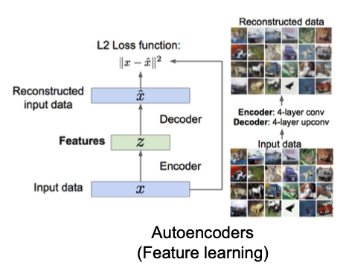
Autoencoder
An autoencoder is a feed-forward neural net whose job it is to take an input x and predict x.
Why autoencoders? Learn abstract features in an unsupervised way so you can apply them to a supervised task

Slide 7
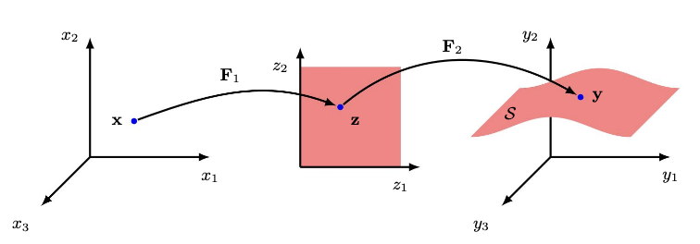
Visualization of an Autoencoder
We can think of an encoder as mapping the input x to its latent representation z, where z lies in a lower-dimensional space that captures the essential features of x.
The decoder then takes this lower-dimensional representation z and maps it back to the original space, reconstructing an output that lies on the same data manifold in the full high-dimensional space.
This process ensures that even though the representation is compressed, it still retains the most important structural and semantic information necessary for accurate reconstruction.

Slide 8
Dejavu
You’ve actually encountered autoencoder-like concepts before!
One example is the Principal Component Analysis (PCA), which transforms the original data into a set of principal components that capture the most important variations in the data.
However, PCA is a linear method—it finds a lower-dimensional representation by applying a linear transformation (matrix multiplication) to the input data. This limits its ability to model complex, nonlinear relationships.
In this module we will use neural networks to learn a nonlinear mapping between the input and its latent representation.

Slide 9
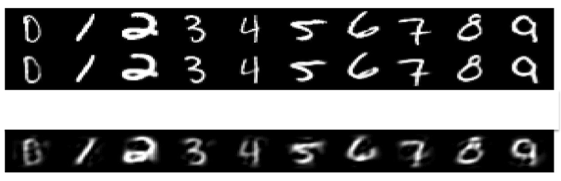
Deep Autoencoder
Deep, nonlinear autoencoders can learn more powerful codes for a given dimensionality, compared with linear autoencoders (PCA)
Real data
30-D deep autoencoder
30-D PCA

Slide 10
Summary of Autoencoder Architecture
Encoder:
Applies convolutional layers (or fully connected layers) to extract features.
Reduces the input to a lower-dimensional latent space.
Latent Representation:
A compressed version of the input that captures essential features.
Decoder:
Uses transposed convolutions (or fully connected layers) to reconstruct the input.
Expands the latent representation back to the original shape.

Slide 11
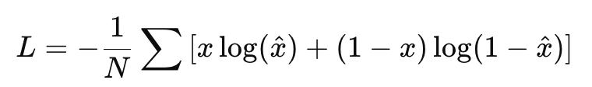
Loss Function
What should we use as a loss function?
Can you see how the reconstructions might be different based on the loss function we choose?
Our criteria is that the reconstructed representation is as close to the original as possible.
Mean Squared Error (MSE) Loss
Measures the average squared difference between the original and reconstructed data.
Binary Cross Entropy (BCE) Loss
We used the BCE for binary classification tasks, where the true value x is either 0 or 1
However, we can also use it when the output is between 0 and 1:

Slide 12
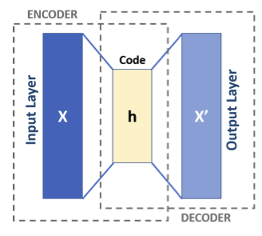

Types of Autoencoders
If the hidden layer has too few constraints, we can get perfect reconstruction without learning anything useful. In order to learn useful hidden representations, a few common constraints are:
Low-dimensional hidden layer. Sometimes we call h a bottleneck.
Sparse autoencoder: use a large hidden layer, but regularize the loss using a penalty that encourages h to be mostly zeros, e.g.,
Variational autoencoder: like a sparse autoencoder, but the penalty encourages h to match a predefined prior distribution (will see in a few slides)
Image Source: https://commons.wikimedia.org/wiki/File:Autoencoder_schema.png

Slide 13
Encoder Architecture
Encoder consists of several convolution layers followed by fully connected layers.
Using Convolutional Layers
Recall that for an image input, the number of features corresponds to the number of pixels. Directly flattening the image loses its spatial structure.
How can we reduce the dimensionality, while preserving spatial information as much as possible? We can use convolutions!!

Slide 14
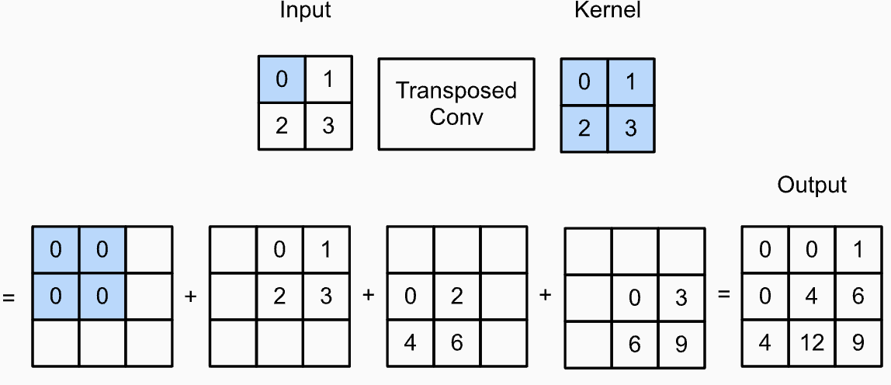
Decoder Architecture
Decoder consists of a fully connected layer followed by several convolutional transpose layers.
See animation
Can we define simple operations analogous to convolutions, but working in the “opposite direction”?
Convolutional transpose layers:
Note: In Module 8 we will see an alternative way to “upsample the grid”.
Image Source: https://d2l.ai/chapter_computer-vision/transposed-conv.html

Slide 15
Model Training and Image Generation
Having defined the Encoder and Decoder architectures, our Autoencoder model is simply the encoder followed by the decoder, forming a compressed representation of the input data and then reconstructing it back.
Training the Autoencoder
We train the model using a reconstruction loss like MSE or BCE, which measure how well the output (reconstructed data) matches the original input.
In theory, to generate new images we can simply sample the latent space and use only the Decoder to “reconstruct” the corresponding image.

Slide 16
Variational Autoencoder

Slide 17
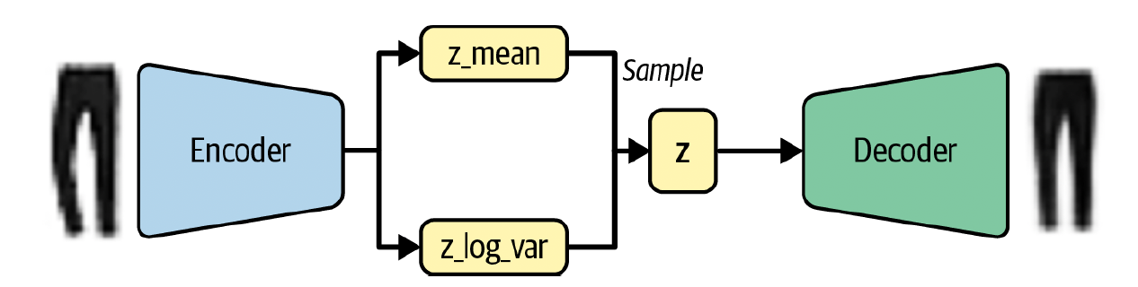
Slight Modification
To implement a Variational Autoencoder (VAE), we retain the general autoencoder architecture but introduce a key modification.
Instead of directly mapping the input image x to a latent representation z, we map it to a probability distribution in the latent space.
The encoder outputs:
z_mean​ (mean of the latent space distribution).
z_log_var (log variance of the distribution, used instead of variance for numerical stability, as it spans (−∞,∞)).
To generate novel outputs, we then “sample” a z value from that distribution to feed into the decoder.

Slide 18
Regularizing the Variational Autoencoder
In practice, allowing the encoder too much freedom in learning the latent space can lead to poorly structured representations. Without constraints, the encoder might overfit to the training data, losing the generative capabilities of the Variational Autoencoder (VAE).
To prevent this, an additional loss term is introduced to penalize the encoder if its learned latent distribution diverges too much from a standard normal distribution with mean 0 and variance 1 - N(0,1).

Slide 19

New Loss Function
The Kullback-Leibler (KL) Divergence quantifies how much one probability distribution differs from another.
In our case it corresponds to how much the learned latent distribution differs from a standard normal distribution and can be shown to have a special form:
-0.5 * sum(1 + z_log_var - z_mean ^ 2 - exp(z_log_var))
The final loss function that we use in training VAE takes the form:

Slide 20
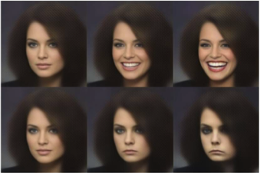
VAE are Generative Models
Variational Autoencoders are generative models for the distribution of data P(x)
The latent space often captures underlying structure in the data in a smooth manner
Varying continuously in different directions can result in plausible variations in the drawn output
Reproductions of an input can be manipulated by wiggling z around its expected value!

Slide 21
Summary of Variational Autoencoder
Practical:
Variational Autoencoder
Encoder:
Computes the distribution P(z|x) for any x
Decoder:
Tries to convert a randomly sampled z from P(z|x) to x
Constraint on z: Make P(z|x) as close to the standard Gaussian as possible

Slide 22
Implementing VAE in PyTorch
Class Activity: Adding a VAE model to the reusable codebase

